Slide 1
PYTHON PROGRAMMING
Mrs. S.Haseena,
Assistant Professor(Senior Grade),
Department of IT,
Mepco Schlenk Engineering College(Autonomous)

Slide 2
Introduction
Programming language – Guido Van Rossum
Variety of platforms
Simple syntax, few lines of code
Object oriented, interpreted, interactive
High level language
Indentation
GNU GPL
Python versions

Slide 3
Features of Python
Platform independent
Free and open source software
Portable
Extendable
GUI programming
Database
Broad Standard library
Dynamic typing

Slide 4
Modes of Execution
Interactive shell
Script mode

Slide 5

Python Virtual Machine (PVM)

Slide 6
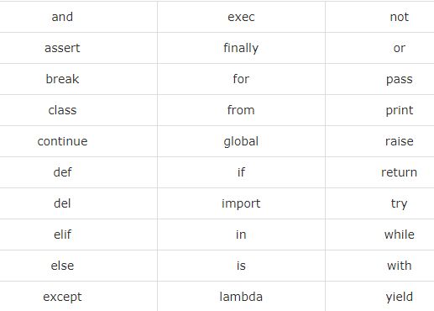
Keywords

Slide 7
Python Installation
https://www.python.org/
IDLE or sophisticated IDE’s
> python --version
>python
>>>print(“Hello,World”)
>>>exit() or quit()
File – test.py
>python test.py

Slide 8
Comments in Python
Single Line Comment
# First comment print
Multiline Comment
“””this is a
Multiline
Comment”””

Slide 9
Variable Names
A variable can have a short name (like x and y) or a more descriptive name (age, carname, total_volume).
Rules for Python variables:
A variable name must start with a letter or the underscore character
A variable name cannot start with a number
A variable name can only contain alpha-numeric characters and underscores (A-z, 0-9, and _ )
Variable names are case-sensitive (age, Age and AGE are three different variables)

Slide 10
Output Variables
The Python print statement is often used to output variables.
To combine both text and a variable, Python uses the + character:
>>> x = "awesome"
>>> print("Python is " + x)
Python is awesome

Slide 11
Contd..
>>> x = "Python is "
>>> y = "awesome"
>>> z = x + y
>>> print(z)
Python is awesome

Slide 12
Assigning Values to Variables
>>> a=1000
>>> b=1.0
>>> c="abi“
>>> print (a)
1000
>>> print (b)
1.0
>>> print (c)
abi

Slide 13
Multiple Assignment
>>> a = b = c = 1
>>> print (c)
1
>>> print (b)
1
>>> print (a)
1

Slide 14
Contd..
>>> a,b,c = 1,2,"john"
>>> print (a)
1
>>> print (b)
2
>>> print (c)
john

Slide 15
Contd.,
>>> x = 5
>>> y = 10
>>> print(x + y)
15
>>> x = 5
>>> y = "John"
>>> print(x + y)
Traceback (most recent call last):
File "<stdin>", line 1, in <module>
TypeError: unsupported operand type(s) for +: 'int' and 'str‘

Slide 16
Reading input from the console
Enables the program to accept input from the user.
variable = input("Enter a value: ")
print(variable)

Slide 17
Numbers
Number data types store numeric values.
Number objects are created when you assign a value to them.
Python supports four different numerical types −
int (signed integers)
long (long integers, they can also be represented in octal and hexadecimal)
float (floating point real values)
complex (complex numbers)

Slide 18
Int
Int, or integer, is a whole number, positive or negative, without decimals, of unlimited length.
>>> x = 7
>>> y = 45435346656765756756765
>>> z = -65757667
>>> print(type(x))
<class 'int'>
>>> print(type(y))
<class 'int'>
>>> print(type(z))
<class 'int'>

Slide 19
Float
Float is a number, positive or negative, containing one or more decimals.
>>> x = 1.10
>>> y = 1.0
>>> z = -35.59
>>> print(type(x))
<class 'float'>
>>> print(type(y))
<class 'float'>
>>> print(type(z))
<class 'float'>

Slide 20
Contd.,
Float can also be scientific numbers with an "e" to indicate the power of 10.
>>> x = 35e3
>>> y = 12E4
>>> z = -87.7e100
>>> print(type(x))
<class 'float'>
>>> print(type(y))
<class 'float'>
>>> print(type(z))
<class 'float'>

Slide 21
Complex
Complex numbers are written with a "j" as the imaginary part:
>>> x = 3+5j
>>> y = 5j
>>> z = -5j
>>> print(type(x))
<class 'complex'>
>>> print(type(y))
<class 'complex'>
>>> print(type(z))
<class 'complex'>

Slide 22
Specify a Variable Type
Integers:
x = int(1) # x will be 1 y = int(2.8) # y will be 2 z = int("3") # z will be 3
Floats:
x = float(1) # x will be 1.0 y = float(2.8) # y will be 2.8 z = float("3") # z will be 3.0 w = float("4.2") # w will be 4.2
Strings:
x = str("s1") # x will be 's1' y = str(2) # y will be '2' z = str(3.0) # z will be '3.0'

Slide 23
Math and Random Function
>>> import math
>>> math.pi
3.141592653589793
>>> math.sqrt(85)
9.219544457292887
>>> import random
>>> random.random()
0.7082048489415967
>>> random.choice([1, 2, 3, 4])
1

Slide 24
Strings
A string is a sequence of characters.
String values must be enclosed in matching single quotes (') or double quotes (").
Python does not have a data type for characters.
A single-character string represents a character

Slide 25
# 2 ways to represent string
>>> string = “Hello World"
>>> string = ' Hello World'
# Slice
>>> print(string[1])
#Range slice
>>> print(string[2:5])
>>> print(string[2:])
#Repetition
>>> print(string*2)
#Concatenation
>>> print(string+“Hai")

Slide 26
#Strip function
>>> string = " Hello World"
#length function
>>> print(len(string))
#lowercase function
>>> print(string.lower())
#uppercase function
>>> print(string.upper())
#Replace function
>>> print(string.replace("o", "O"))
>>> print(string.replace(“L", "O"))

Slide 27
Lists
A list can store a collection of data of any size.
Python provides a type called a list that stores a sequential collection of elements.
list1 = [] # Same as list()
list2 = [2, 3, 4] # Same as list([2, 3, 4])
list3 = ["red", "green"] # Same as list(["red", "green"])
list4 = [2, "three", 4]

Slide 28
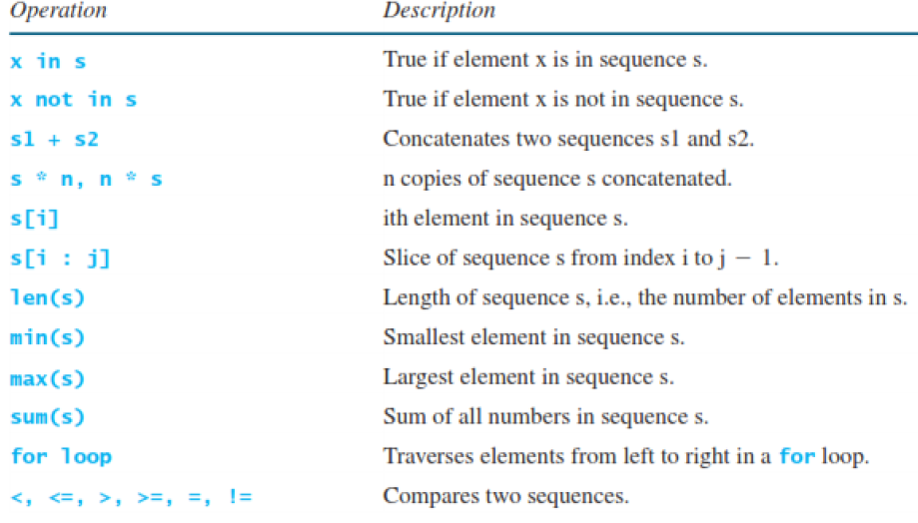

Slide 29

Traverse a List

Slide 30
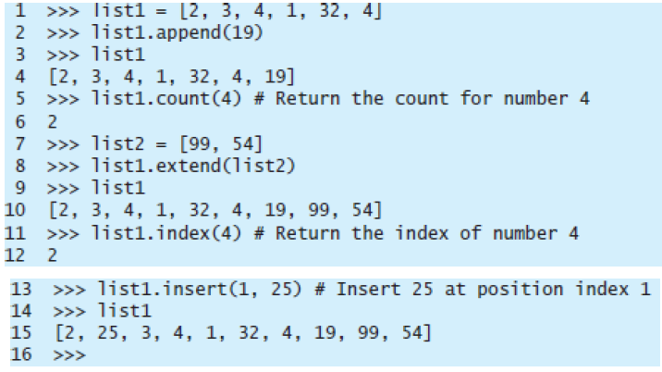
List Methods

Slide 31
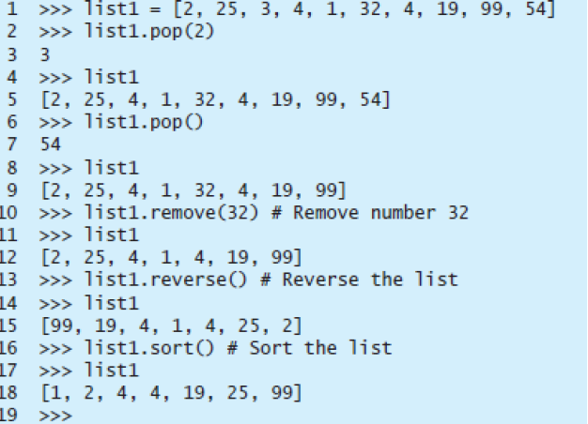

Slide 32
Sets
Sets are like lists in that you use them for storing a collection of elements.
Unlike lists, however, the elements in a set are non-duplicates and are not placed in any particular order.
If your application does not care about the order of the elements, using a set to store elements is more efficient than using lists due to Python’s implementations.

Slide 33
Creating a Set
s1 = set() # Create an empty set
s2 = {1, 3, 5} # Create a set with three elements
s3 = set([1, 3, 5]) # Create a set from a tuple
# Create a set from a list
s4 = set([x * 2 for x in range(1, 10)])

Slide 34
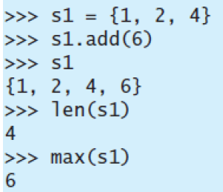
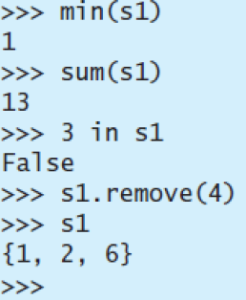
Operations in Set

Slide 35
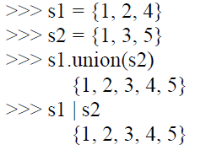
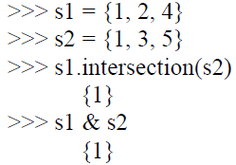
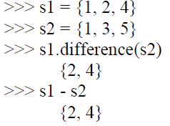
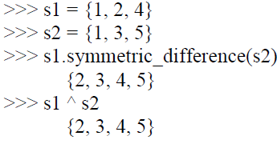

Slide 36
Tuples
Tuples are like lists, but their elements are fixed; that is, once a tuple is created, you cannot add new elements, delete elements, replace elements, or reorder the elements in the tuple.
If the contents of a list in your application shouldn’t change, you can use a tuple to prevent elements from being added, deleted, or replaced accidentally.
You create a tuple by enclosing its elements inside a pair of parentheses.

Slide 37
Creating a Tuple
t1 = () # Create an empty tuple
t2 = (1, 3, 5) # Create a tuple with three elements
# Create a tuple from a list
t3 = tuple([2 * x for x in range(1, 5)])
# Create a tuple from a string
t4 = tuple("abac") # t4 is ['a', 'b', 'a', 'c']

Slide 38
Operations in Tuple
tuple1 = ("green", "red", "blue") # Create a tuple
tuple2 = tuple([7, 1, 2, 23, 4, 5]) # Create a tuple from a list
print("length is", len(tuple2)) # Use function len use functions
print("max is", max(tuple2)) # Use max
print("min is", min(tuple2)) # Use min
print("sum is", sum(tuple2)) # Use sum
print("The first element is", tuple2[0]) # Use index operator
tuple3 = tuple1 + tuple2 # Combine two tuples
tuple3 = 2 * tuple1 # Duplicate a tuple
print(tuple2[2 : 4]) # Slicing operator

Slide 39
Dictionaries
A dictionary is a container object that stores a collection of key/value pairs.
It enables fast retrieval, deletion, and updating of the value by using the key.
Creating a dictionary:
students = {} //Empty Dictionary
students = {"111-34-3434":"John", "132-56-6290":"Peter"} //with two items

Slide 40
Adding and Modifying Values:
To add an item to a dictionary, use the syntax:
dictionaryName[key] = value
For example:
students["234-56-9010"] = "Susan"
If the key is already in the dictionary, the preceding statement replaces the value for the key.

Slide 41
Retrieving Values:
To retrieve a value, simply write an expression using
dictionaryName[key]
If the key is in the dictionary, the value for the key is returned.
Deleting Items:
To delete an item from a dictionary, use the syntax:
del dictionaryName[key]
For example:
del students["234-56-9010"]

Slide 42
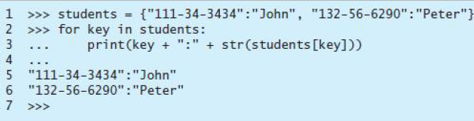
Looping Items

Slide 43

Python Conditional Statements
if boolean-expression:
#statements
else:
#statements

Slide 44
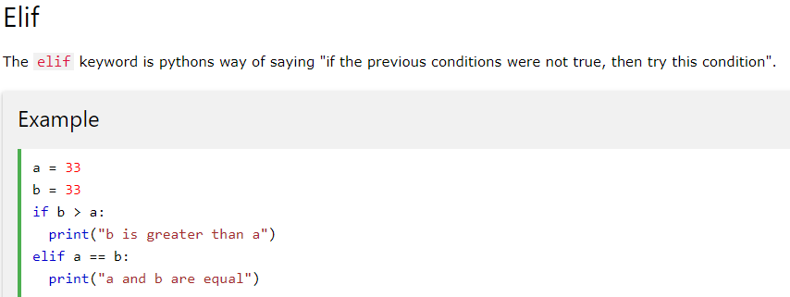

Slide 45
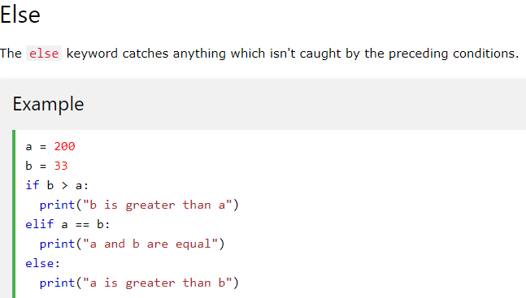

Slide 46
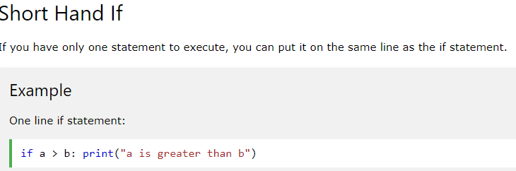

Slide 47
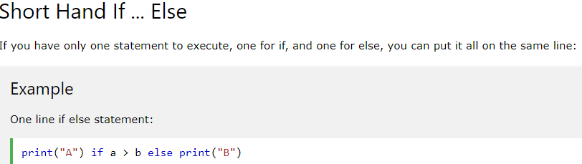

Slide 48
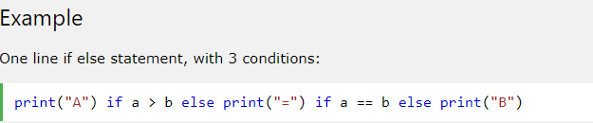

Slide 49
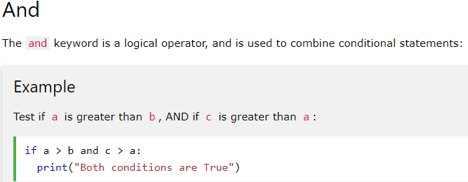

Slide 50
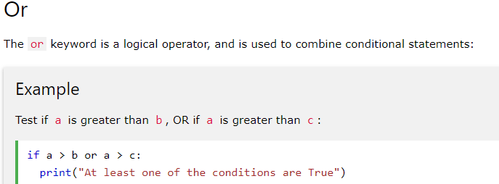

Slide 51
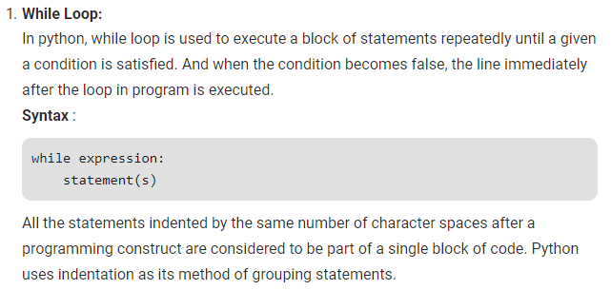
Looping Statements

Slide 52


Slide 53

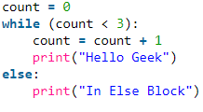
While . . . Else

Slide 54
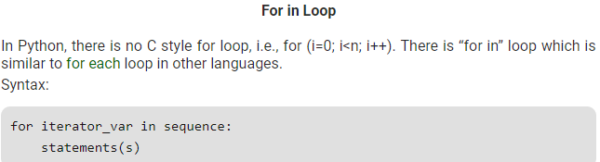

Slide 55
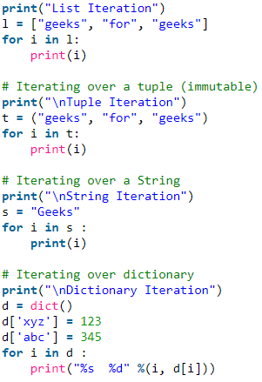

Slide 56
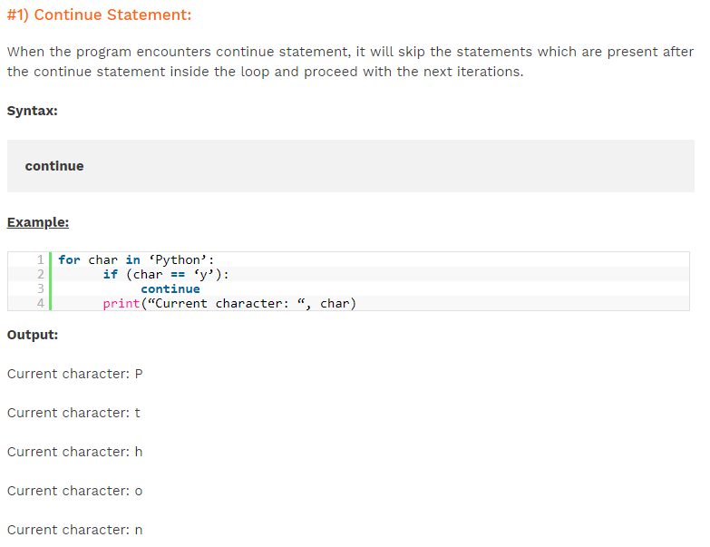

Slide 57
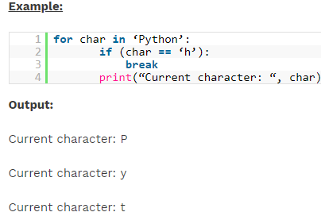

Slide 58
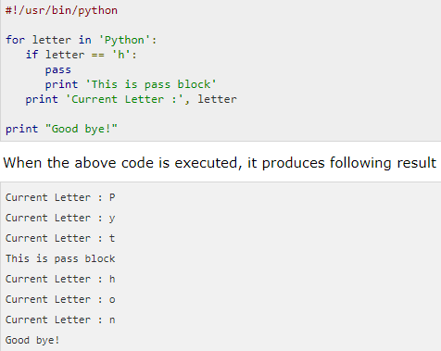

Slide 59
Function
A function is a block of organized, reusable code that is used to perform a single, related action.
Functions provide better modularity for your application and a high degree of code reusing.
Python gives many built-in functions like print(), etc. but you can also create your own functions. These functions are called user-defined functions.

Slide 60
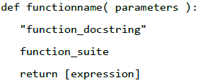
Defining Functions

Slide 61
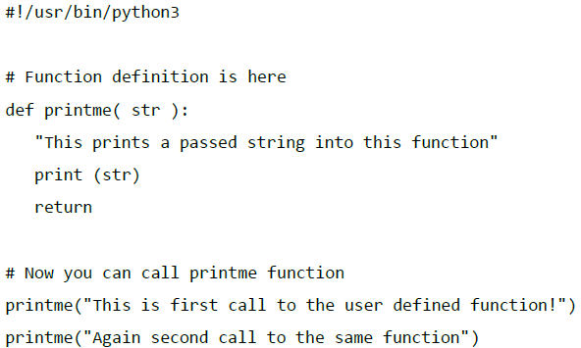
Calling a Function

Slide 62
Database Concepts in Python
SQLite: A very powerful, embedded relational database management system.
SQLite is an amazing library that gets embedded inside the application that makes use of.

Slide 63
_{SQLites Datatypes:}
NULL: NULL value.
INTEGER: Signed integer, stored in 1, 2, 3, 4, 6, or 8 bytes depending on the magnitude of the value.
REAL: Floating point value, stored as an 8-byte IEEE floating point number.
TEXT: Text string, stored using the database encoding (UTF-8, UTF-16BE or UTF-16LE).
BLOB: A blob of data, stored exactly as it was input.

Slide 64
Programming in python:
1. Import the library sqlite3
2. The connect operation makes a “connection” to the database stored in the file music.sqlite3 in the current directory. If the file does not exist, it will be created.
3. A cursor is like a file handle that we can use to perform operations on the data stored in the database. Calling cursor() is very similar conceptually to calling open() when dealing with text files.

Slide 65
Connect To Database
If the database does not exist, then it will be created and finally a database object will be returned.
#!/usr/bin/python
import sqlite3
conn = sqlite3.connect('test.db')
print (“Opened database successfully”)

Slide 66
Create a Table
import sqlite3
conn = sqlite3.connect('test.db')
print("Opened database successfully")
conn.execute('''CREATE TABLE COMPANY
(ID INT PRIMARY KEY NOT NULL,
NAME TEXT NOT NULL,
AGE INT NOT NULL,
ADDRESS CHAR(50),
SALARY REAL);''')
print("Table created successfully")
conn.close()

Slide 67
INSERT Operation
import sqlite3
conn = sqlite3.connect('test.db')
print("Opened database successfully")
conn.execute("INSERT INTO COMPANY (ID,NAME,AGE,ADDRESS,SALARY) VALUES (1, 'Paul', 32, 'California', 20000.00 )");
conn.execute("INSERT INTO COMPANY (ID,NAME,AGE,ADDRESS,SALARY) VALUES (2, 'Allen', 25, 'Texas', 15000.00 )");
conn.commit()
print("Records created successfully")
conn.close()

Slide 68
SELECT Operation
import sqlite3
conn = sqlite3.connect('test.db')
print("Opened database successfully")
cursor = conn.execute("SELECT id, name, address, salary from COMPANY")
for row in cursor:
print ("ID = ", row[0])
print ("NAME = ", row[1])
print ("ADDRESS = ", row[2])
print ("SALARY = ", row[3], "\n")
print ("Operation done successfully")
conn.close()

Slide 69
UPDATE Operation

Slide 70
import sqlite3
conn = sqlite3.connect('test.db')
print("Opened database successfully")
conn.execute("UPDATE COMPANY set SALARY = 5000.00 where ID = 1")
conn.commit
print ("Total number of rows updated :", conn.total_changes)
cursor = conn.execute("SELECT id, name, address, salary from COMPANY")
for row in cursor:
print ("ID = ", row[0])
print ("NAME = ", row[1])
print ("ADDRESS = ", row[2])
print ("SALARY = ", row[3], "\n")
print ("Operation done successfully")
conn.close()

Slide 71
DELETE operation
import sqlite3
conn = sqlite3.connect('test.db')
print("Opened database successfully")
conn.execute("DELETE from COMPANY where ID = 2;")
conn.commit()
print ("Total number of rows updated :", conn.total_changes)
cursor = conn.execute("SELECT id, name, address, salary from COMPANY")
for row in cursor:
print ("ID = ", row[0])
print ("NAME = ", row[1])
print ("ADDRESS = ", row[2])
print ("SALARY = ", row[3], "\n")
print ("Operation done successfully")
conn.close()

